Slide 1
Fairfield County Short Term Rental Public Meeting
Fairfield County Government Complex
Thursday 11-30-2023

Slide 2
Purpose For Today’s Meeting
Present Fairfield County Administration and Community Development’s ideas regarding short term rentals.
Receive written and verbal feedback from the community regarding short term rentals.
Provide the public with the next steps required to draft a short term rental ordinance for review and passing by Fairfield County Council.

Slide 3
How Did We Get Here?
Request was made to Fairfield County Council to address short term rentals.
County Council directed Fairfield County Administration to investigate.
We requested information from other Counties and reviewed model ordinances from SC Association of Counties and other local governments.
An internal work group was created to discuss a proposed ordinance.
Administration, Community Development, Code Enforcement, Sheriff’s Office, Fire Service, Magistrate’s Office

Slide 4
Results of Internal Review and Discussion
Multiple factors influence the review and regulation of short term rentals:
SC Bill H. 3253 – A Bill introduced in January 2023 to prohibit municipal and county governing bodies from enacting or enforcing an ordinance that prohibits the rental of a residential dwelling (In committee)
Fairfield County collects accommodations tax revenue from short term rentals which is used to promote tourism
Limitations with staff when it comes to the enforcement of short term rentals

Slide 5
Results of Internal Review and Discussion
We don’t recommend banning short term rentals in Fairfield County.
We do recommend the creation of standards when it comes to short term rentals within the County.
Standards will be regulated and enforced through the Community Development Department and the Fairfield County Sheriff’s Office.

Slide 6
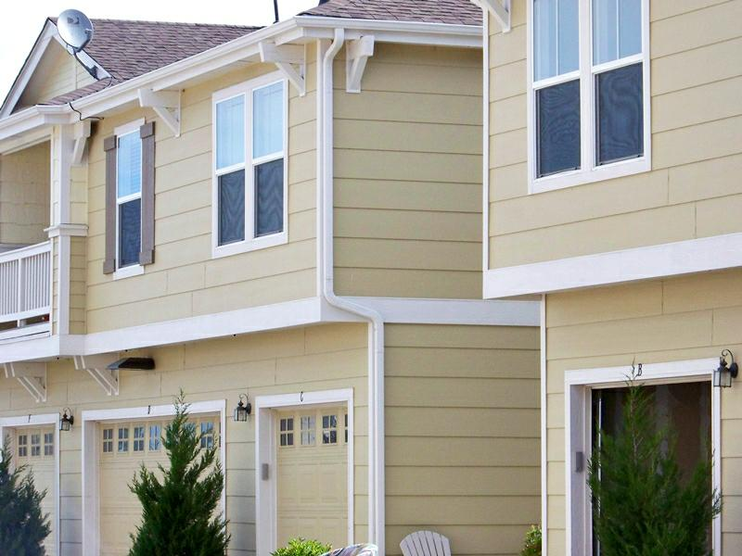
What Is a Short Term Rental
Any overnight stays in a B&B, VRBO, Air B&B, Home Away, Hotel or any other structure that provides short term stays that do not exceed 30 days.

Slide 7
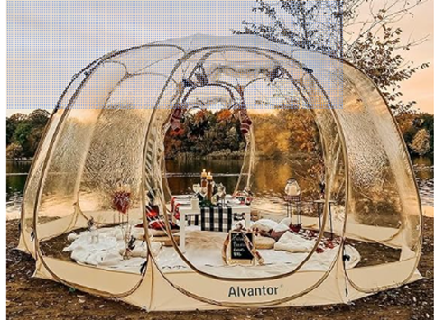
Structures that do not qualify as short term rentals:
Tents, recreational vehicles, campers, boats, yurts or any structure that does not provide electricity and bathroom accommodations.

Slide 8
Proposed Short Term Rental Requirements
A short term rental permit is required.
If applicable, the owner must verify that their home owners association allows short term rentals.
A Fairfield County Business Registration is required.
Owner must pay the 3% accommodation tax and the 2% hospitality tax for the sale of foods and beverages, if applicable.
If there is a change in ownership, the new owner is required to obtain a short term rental permit and pay the accommodation and hospitality taxes within 30 days.

Slide 9
Proposed Short Term Rental Requirements
The owner must identify a local management company or individual who’s located within a 150 mile radius and available within 24 hours.
Anyone under the age of 21, will not qualify to rent the property unless they are accompanied by an adult.
A short term rental would be allowed in all zoning districts, but industrial.
The owner is required to verify the short term rental meets all building code requirements.
If the rental permit expires, the owner has 7 days to bring the rental into compliance.

Slide 10
Proposed Short Term Rental Requirements
Suspected violations can be reported to the Fairfield County Sheriffs Office or the code enforcement section of the Community Development department.
Fines imposed for violations:
1st offense $150.00
2nd offense $300.00
3rd offense $500.00 fine, and all operations of the rental will cease for 6 months. A stop rental decal be affixed. A letter will be sent to the owner that their short terms permit has been revoked.

Slide 11
Feedback/Discussion

Slide 12
Next Steps
Include feedback received from public meeting into proposed guidelines.
Receive legal review of proposed regulation.
Draft ordinance for County Council review.
Present ordinance to County Council.
Approval requires three readings and a public hearing.

