Slide 1


Broadband | The Road Ahead
Closing the SC Digital Divide
February 26, 2024

Slide 2
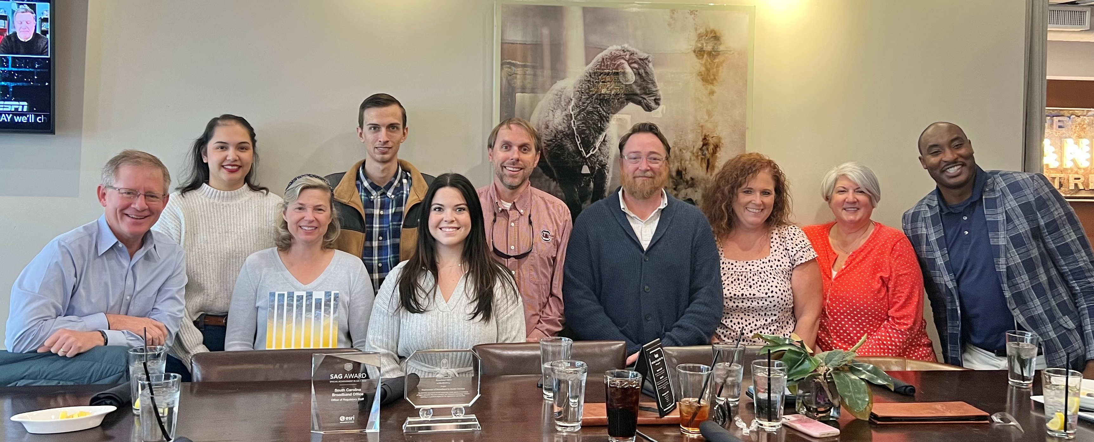
2023 Awards
Esri | Special Achievement in GIS
SC Information Technology Director’s Association | Innovation Award

Slide 3
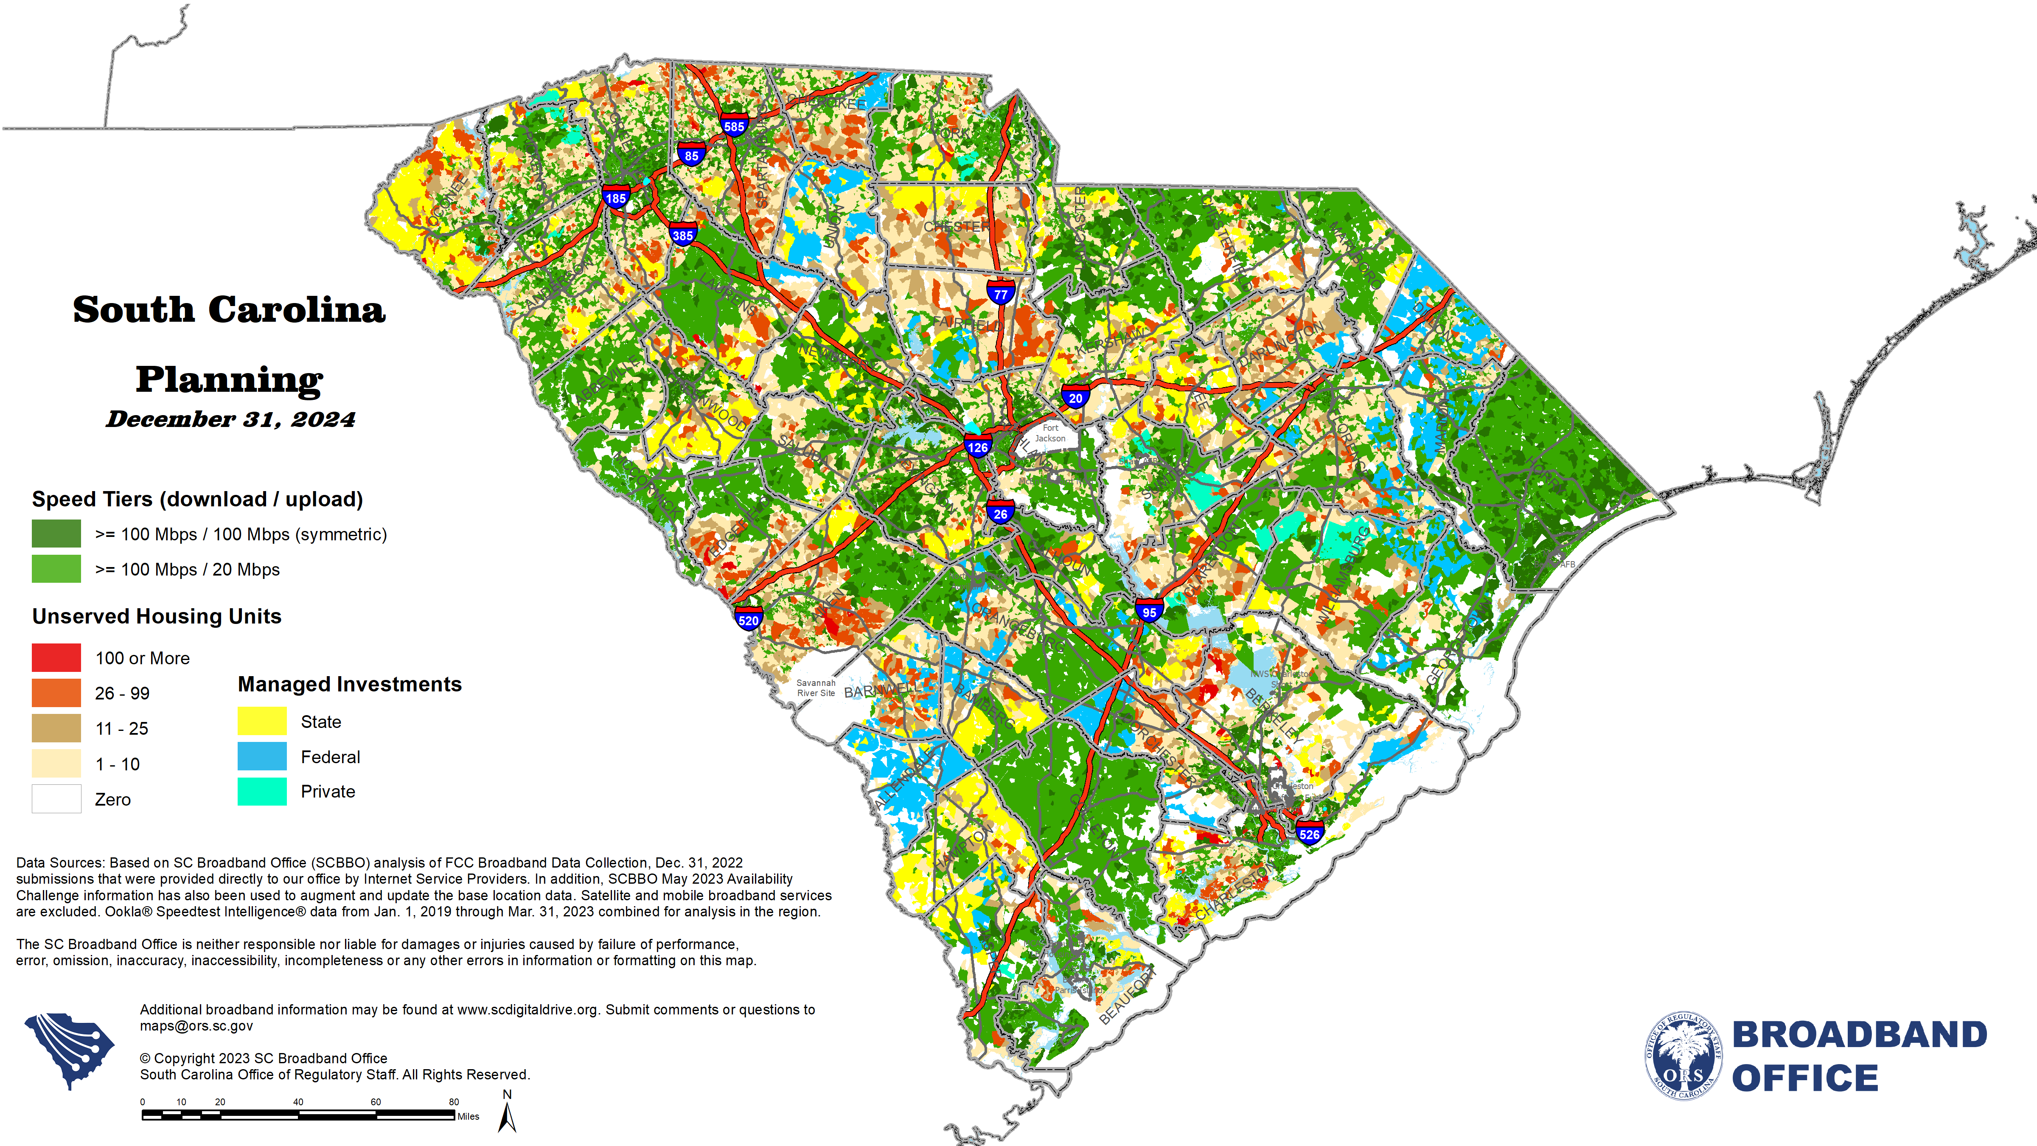

Slide 4
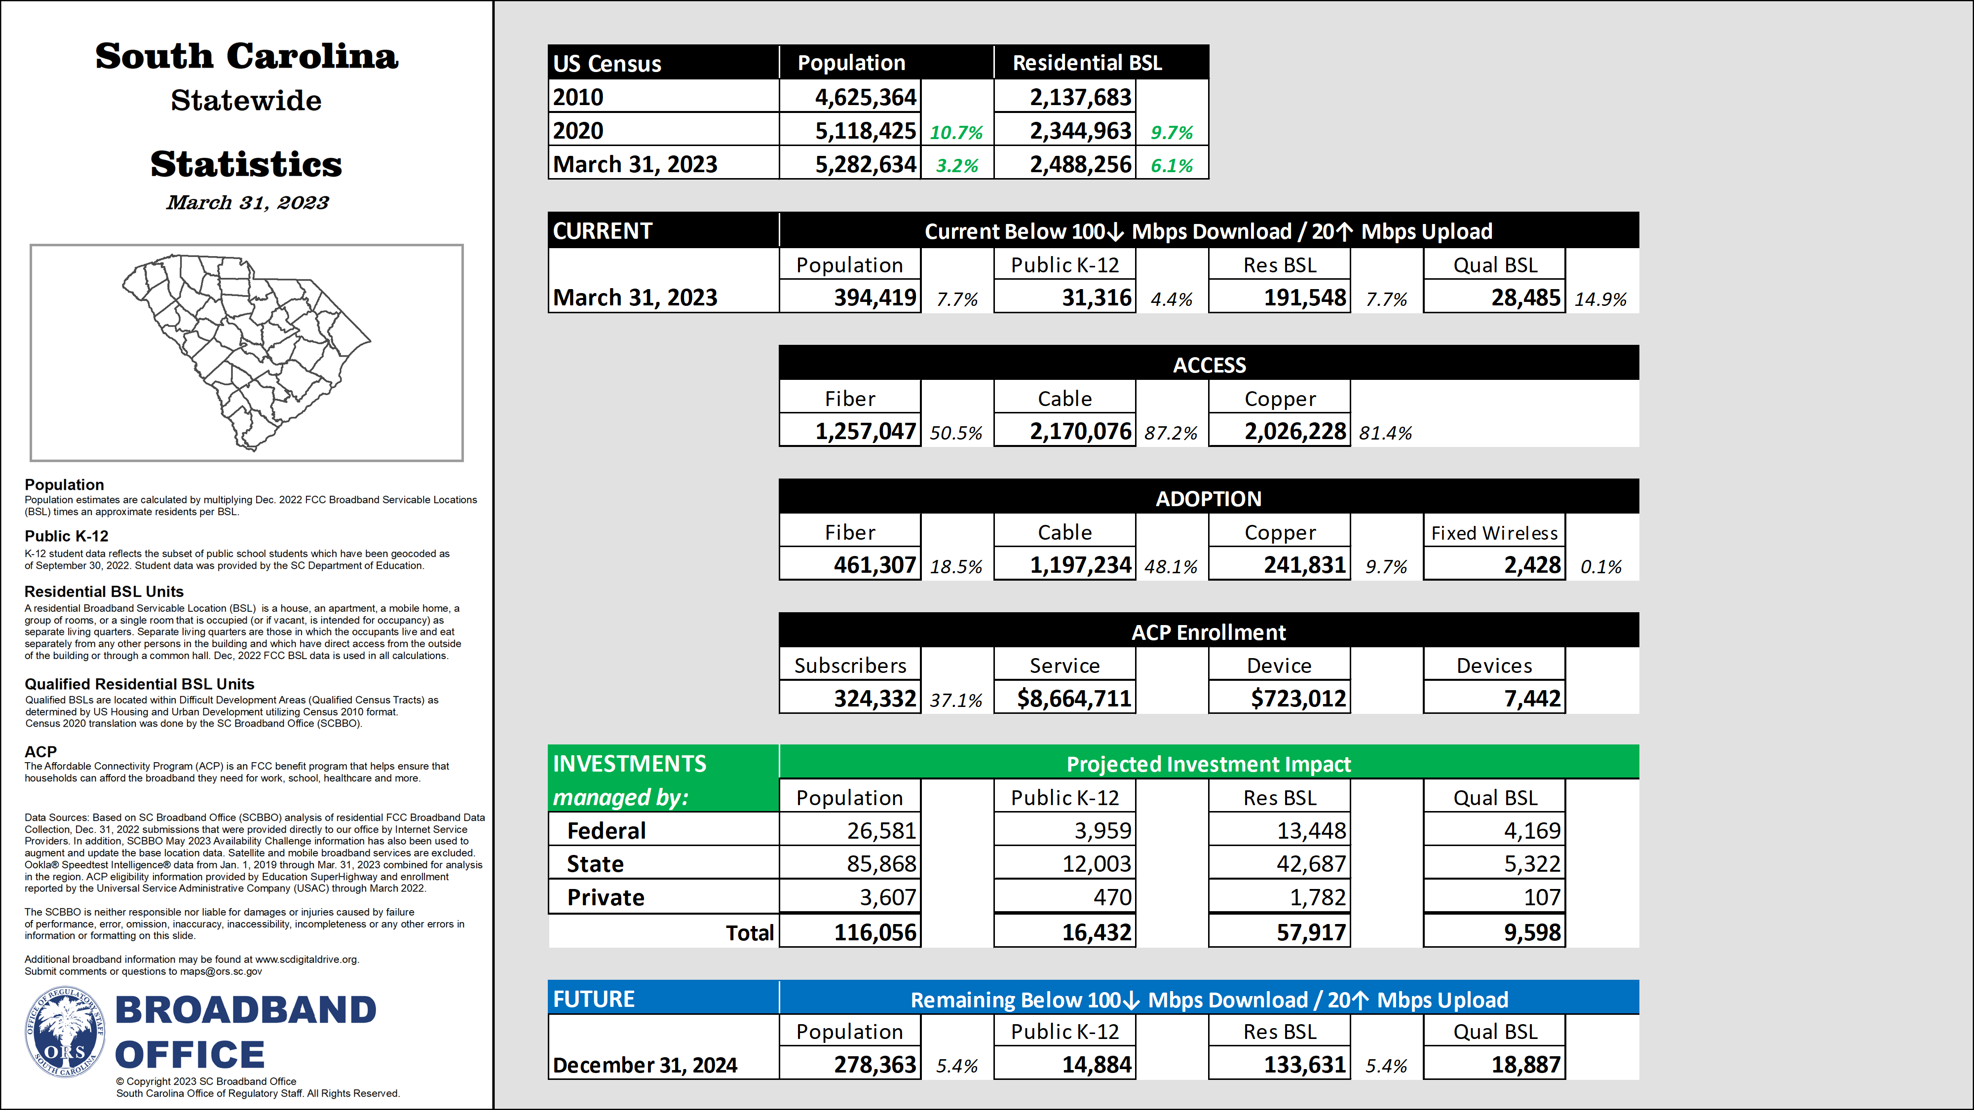

Slide 5
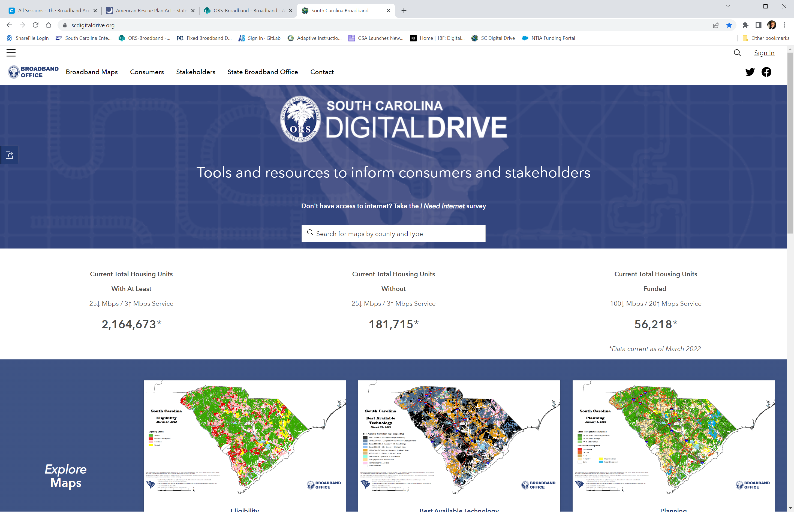
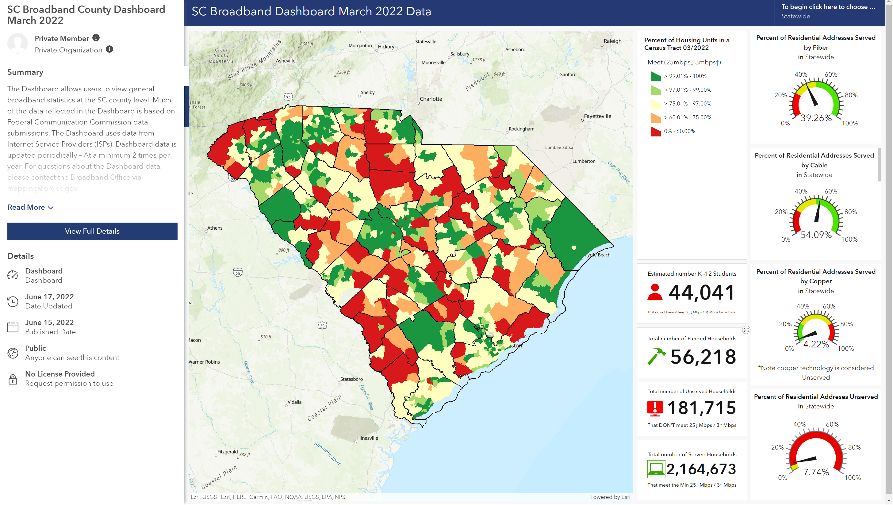
www.SCDigitalDrive.org

Slide 6
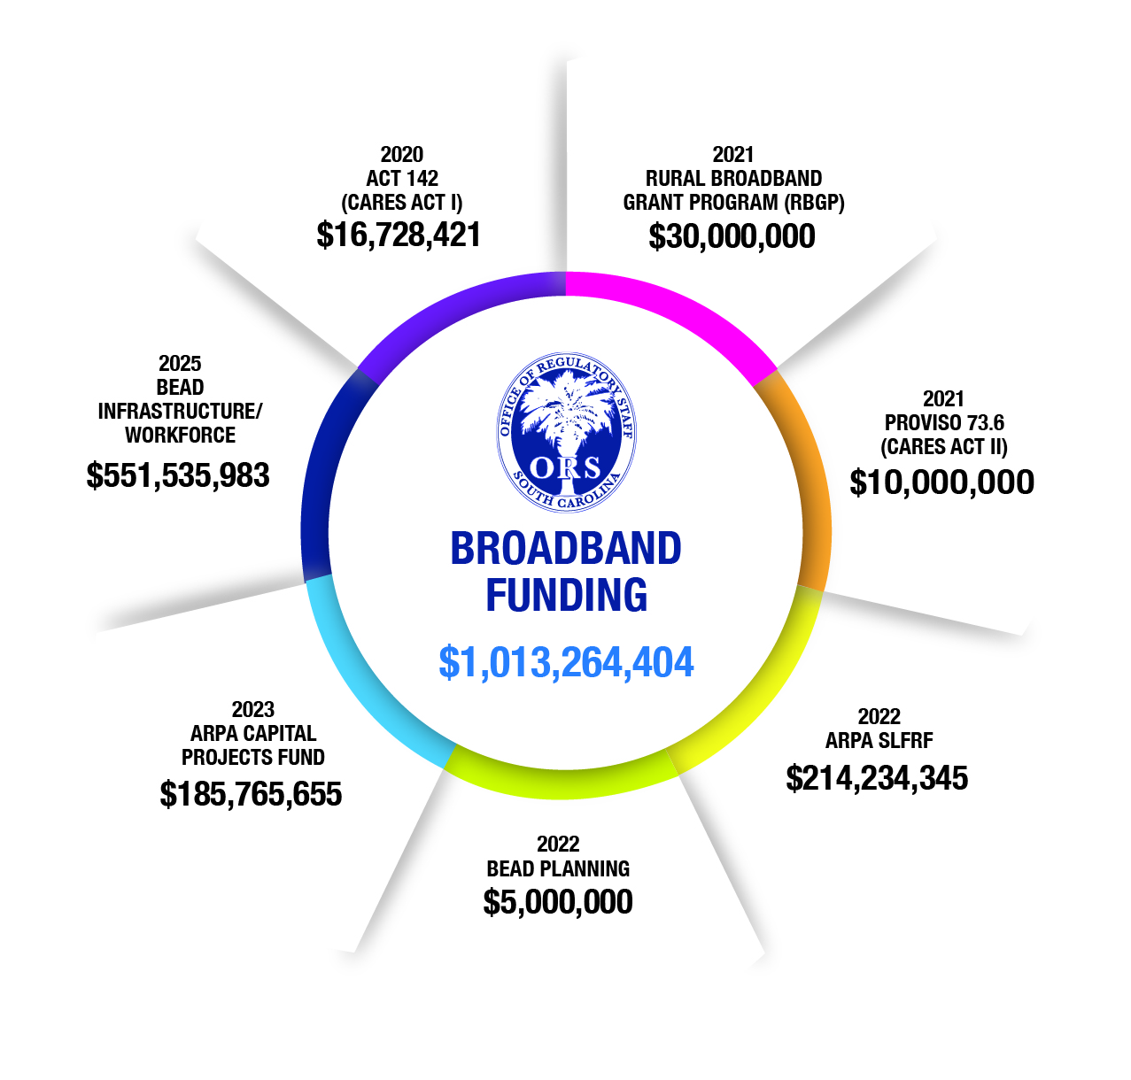
ORS.SC.GOV/Broadband
Notes:
Amy
The ORS engaged Revolution D, Inc. to identify areas of the state that are unserved, impacted
by COVID-19, and that if broadband were available, would support distance learning, telehealth,
and/or teleworking. The ORS solicited applications for expanding broadband infrastructure in
South Carolina. The ORS is currently working with applicants to finalize funding agreements and
projects are scheduled to be completed before December 18, 2020.
The ORS has created a program overview, various press
releases, an application, guidelines, funding agreement,
and reporting tools. Companies are required to submit
Financial Progress Reports and Construction Progress
Reports to the ORS.

Slide 7
ORS.SC.GOV/Broadband
Notes:
Amy
The ORS engaged Revolution D, Inc. to identify areas of the state that are unserved, impacted
by COVID-19, and that if broadband were available, would support distance learning, telehealth,
and/or teleworking. The ORS solicited applications for expanding broadband infrastructure in
South Carolina. The ORS is currently working with applicants to finalize funding agreements and
projects are scheduled to be completed before December 18, 2020.
The ORS has created a program overview, various press
releases, an application, guidelines, funding agreement,
and reporting tools. Companies are required to submit
Financial Progress Reports and Construction Progress
Reports to the ORS.

Slide 8
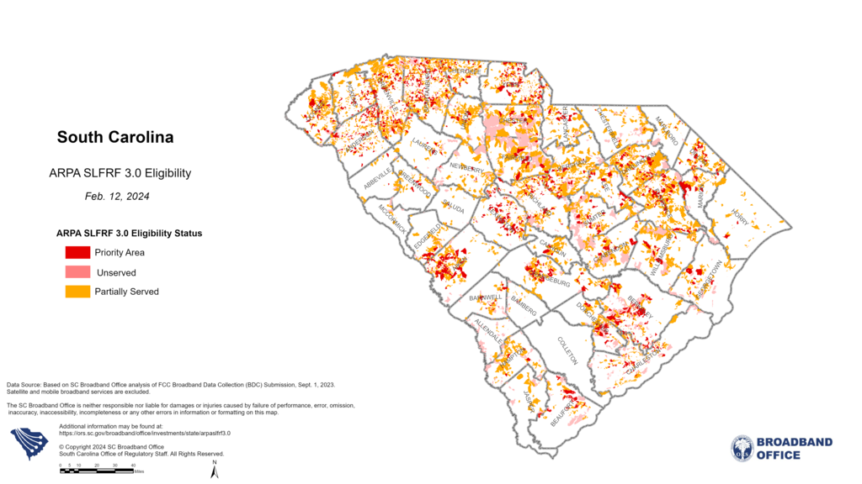
Eligibility | BSL | Units
Residential | 49,986 | 64,633
Business | 10,329 | 10,646
Total | 60,315 | 75,279

Slide 9
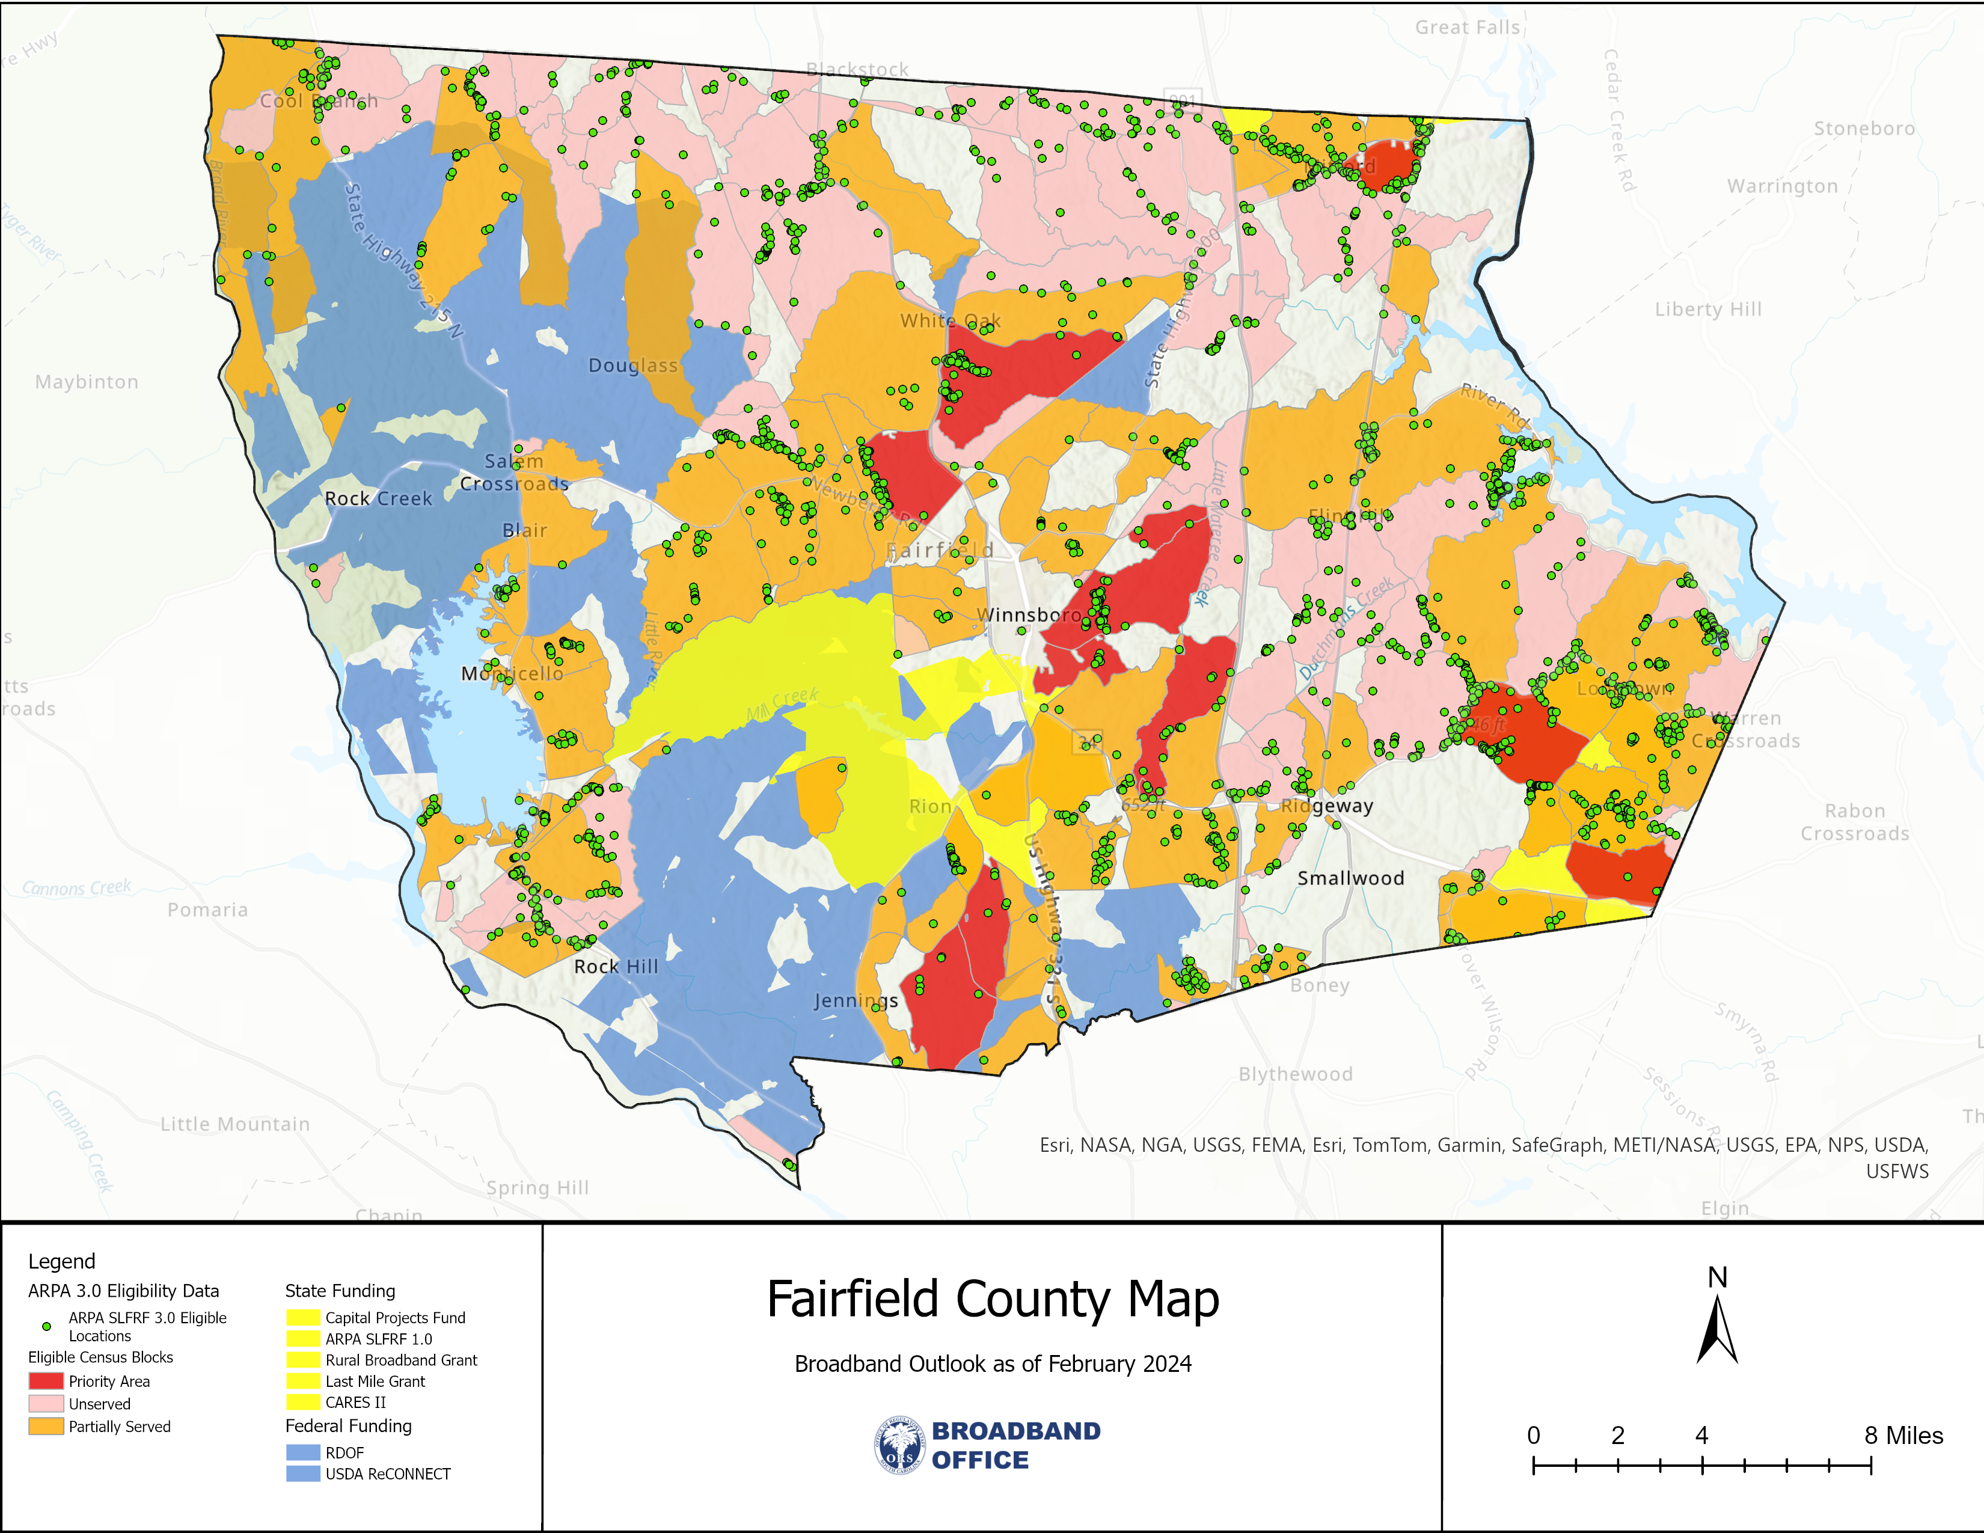
Remaining | BSL | Units
Residential | 1,651 | 2,047
Business | 290 | 292
Total | 1,941 | 2,339

Slide 10

2024 SC BROADBAND GRANT PROGRAMS
Sep. 2023 Maps
Mar. 2024 Maps
Sep. 2024 Maps
FCC Jun. 30, 2023
Ookla Sep. 30, 2023
Publish Feb. 2024
FCC Dec. 31, 2023
Ookla Mar. 31, 2024
Publish Jul. 2024
FCC Jun. 30, 2024
Ookla Sep. 30, 2024
Publish Dec. 2024
FEB
12
MAR
Construction done by Jun. 2026
FEB
12
APR
JUN
30
SEP
JAN
2024
Q2
2022
Last Mile Pilot
Priority Areas
Accelerated
Projects
DEC
2024
Construction by Dec. 2025
Construction through Jun. 30, 2022
ARPA CPF 1.0
ARPA SLFRF 3.0 Grant
Begins 30+ days after challenge
ARPA SLFRF 2.0
90-Day Expected
BEAD Challenge
BEAD Subgrantee Selection
NTIA Curing/Approvals
One time program
* All dates are subject to change without notice, assume timely NTIA approvals.
ORS.SC.GOV/Broadband
Notes:
Amy
The ORS engaged Revolution D, Inc. to identify areas of the state that are unserved, impacted
by COVID-19, and that if broadband were available, would support distance learning, telehealth,
and/or teleworking. The ORS solicited applications for expanding broadband infrastructure in
South Carolina. The ORS is currently working with applicants to finalize funding agreements and
projects are scheduled to be completed before December 18, 2020.
The ORS has created a program overview, various press
releases, an application, guidelines, funding agreement,
and reporting tools. Companies are required to submit
Financial Progress Reports and Construction Progress
Reports to the ORS.

Slide 11
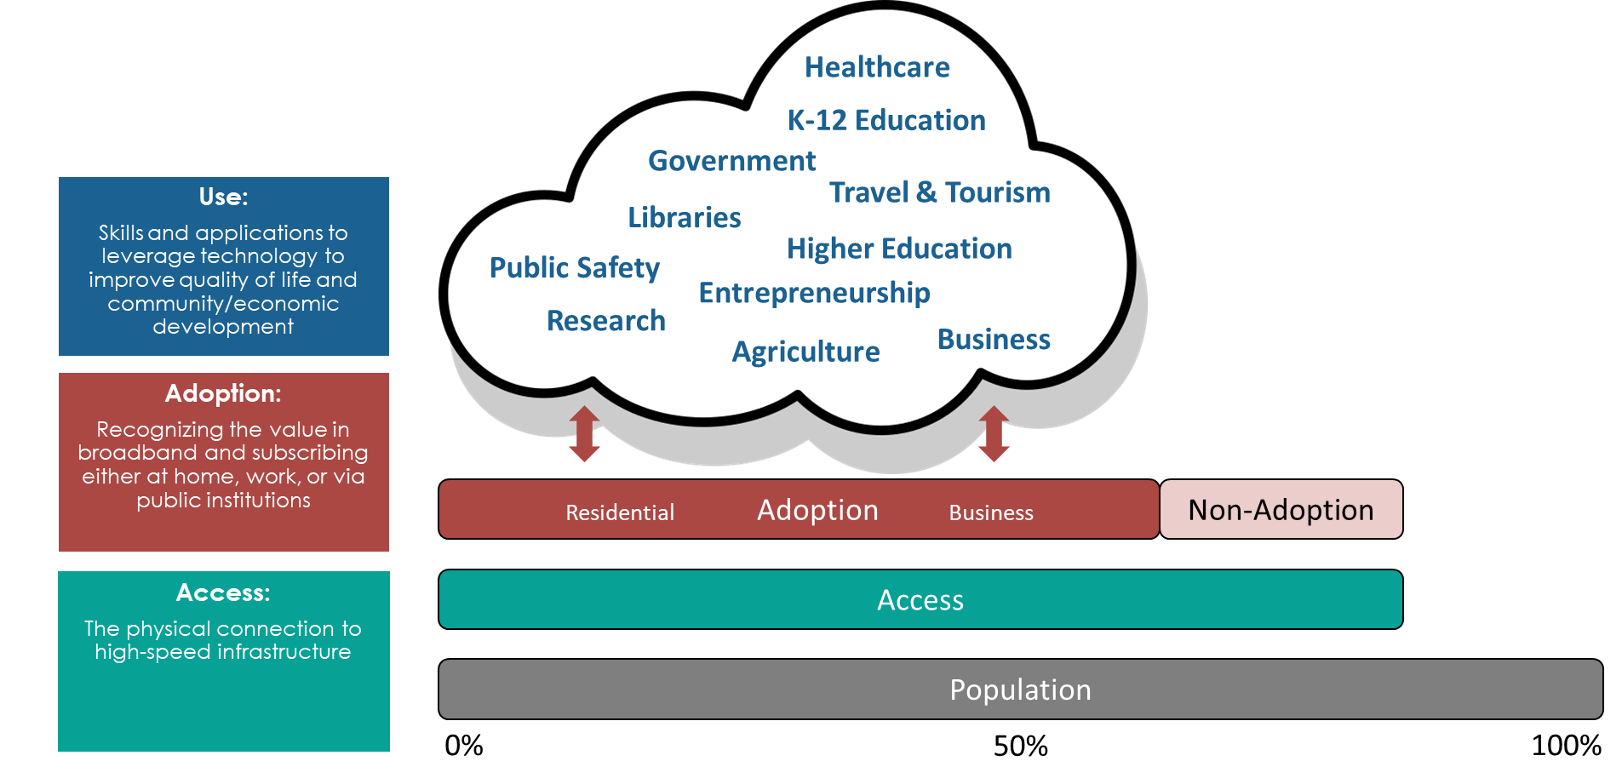
About BEAD
Infrastructure Investment and Jobs Act (IIJA)
  Digital Equity (DE) – Adoption and Use
  Broadband Equity Access and Deployment (BEAD)
    $551.5 million allocation for SC
    Broadband Deployment
      Must provide access to all homes and businesses throughout state (first)
      Next, must connect Community Anchor Institutions (< 1Gbps symmetric)
    Non-Deployment
      Only occurs after SCBBO confirms enough allocation available to provide access to all homes and businesses throughout state
    Initial Proposal
      Volume 1 – BEAD Challenge Process
      Volume 2 – Establishment of BEAD Grant Program

Slide 12

Jim Stritzinger
Director, SC Broadband Office
jstritzinger@ors.sc.gov
Office: (803) 737-0825
Mobile: (803) 606-6398
Thank you!
Notes:
Landon to welcome and introduce webinar- logistics

